Slide 1
Modelling electromagnetic problems in the presence of cased wells
Lindsey J. Heagy¹, Rowan Cockett¹, Douglas W. Oldenburg¹ and Michael Wilt²
¹University of British Columbia Geophysical Inversion Facility
²GroundMetrics

Slide 2
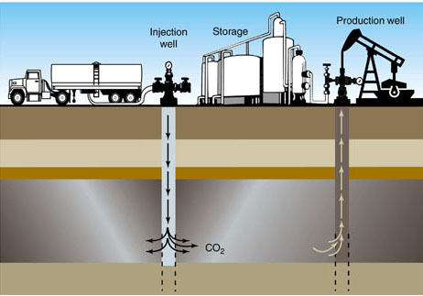
Why?
Electrical conductivity can be a diagnostic physical property
e.g. Monitoring applications
CO₂ sequestration
Locating missed pay
Enhanced Oil Recovery
ie. water floods
Hydraulic fracturing
Source: http://www.oil-price.net/en/articles/novel-crude-oil-recovery.php

Slide 3
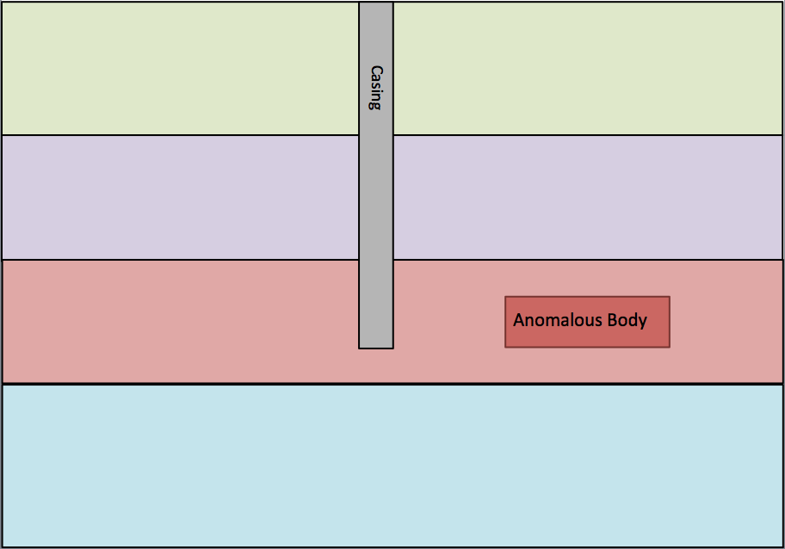
Why?
Electrical conductivity can be a diagnostic physical property
e.g. Monitoring applications
CO₂ sequestration
Locating missed pay
Enhanced Oil Recovery
ie. water floods
Hydraulic fracturing
EM sensitive to conductivity
Inversion: characterize conductivity distribution
Want to characterize this

Slide 4
Why?
Electrical conductivity can be a diagnostic physical property
e.g. Monitoring applications
CO₂ sequestration
Locating missed pay
Enhanced Oil Recovery
ie. water floods
Hydraulic fracturing
EM sensitive to conductivity
Inversion: characterize conductivity distribution
This is a problem.
Want to characterize this

Slide 5
Steel casing in EM
Physical Properties
highly conductive
significant (variable) magnetic permeability
Significant impact on signals
Geometry
cylindrical
thin compared to length
Numerically challenging
This is a problem.
Want to characterize this

Slide 6
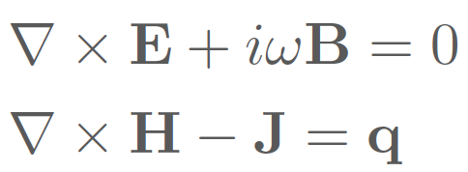
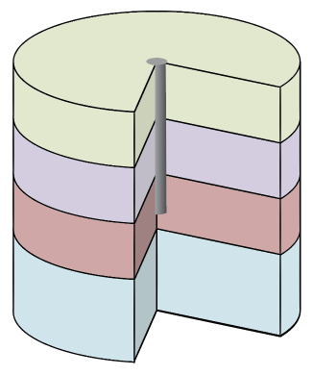
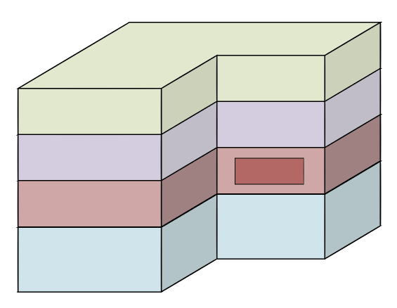
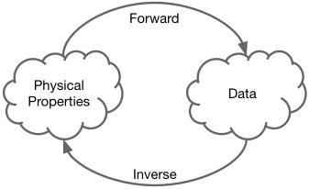
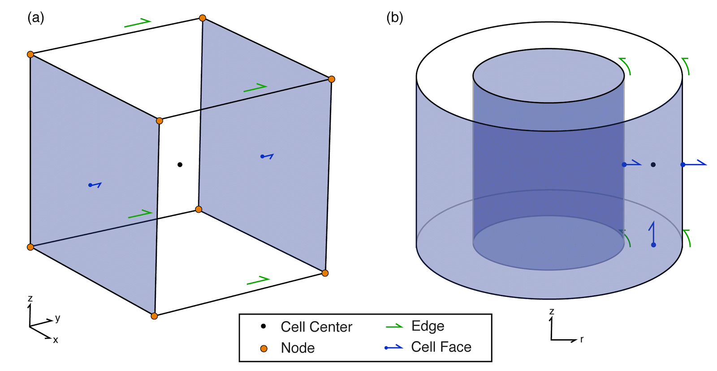

Overview
Motivation: How do we characterize 3D conductivity distributions in settings with steel cased wells?
Modelling Maxwell’s equations
Modelling the Casing
Modelling 3D geology
Approaching the inverse problem

Slide 7
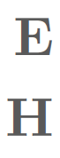
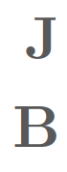
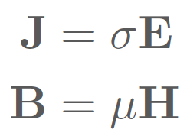
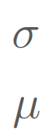
Electromagnetics: Maxwell’s Equations
Maxwell’s Equations
(frequency domain, quasi-static)
Fields
electric field
magnetic field
Fluxes
current density
Constitutive Relations
magnetic flux density
Physical Properties
electrical conductivity
magnetic permeability

Slide 8
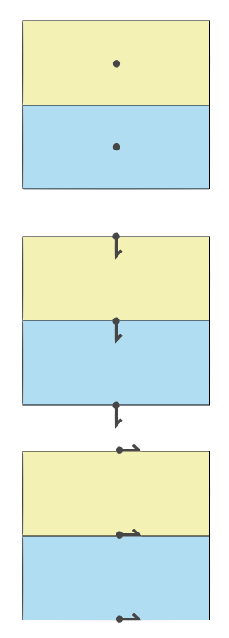
Finite Volume Forward Modelling
Physical Properties
electrical conductivity
magnetic permeability
Fluxes
current density
magnetic flux density
Fields
electric field
magnetic field

Slide 9
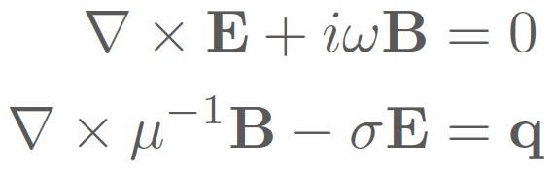
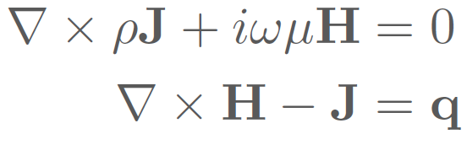
Two Formulations of Maxwell
E-B Formulation:
H-J Formulation:

Slide 10
Cylindrical mesh

Slide 11
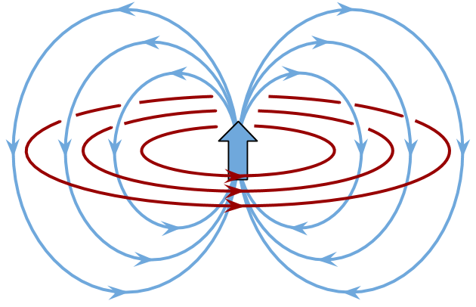
Primary: Cylindrical Symmetry - Dipole
Magnetic Dipole

Slide 12
Primary: Cylindrical Symmetry - Dipole
Electric Dipole

Slide 13
Two Formulations of Maxwell
E-B Formulation:
H-J Formulation:

Slide 14
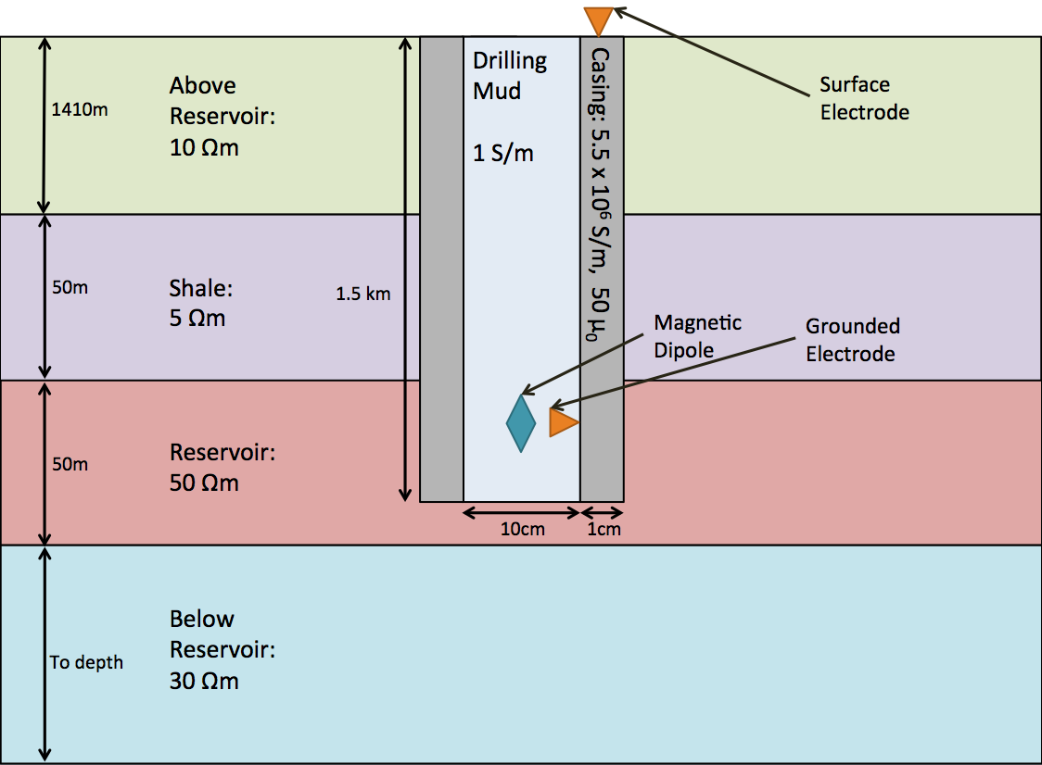
Modelling the casing

Slide 15
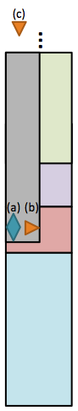

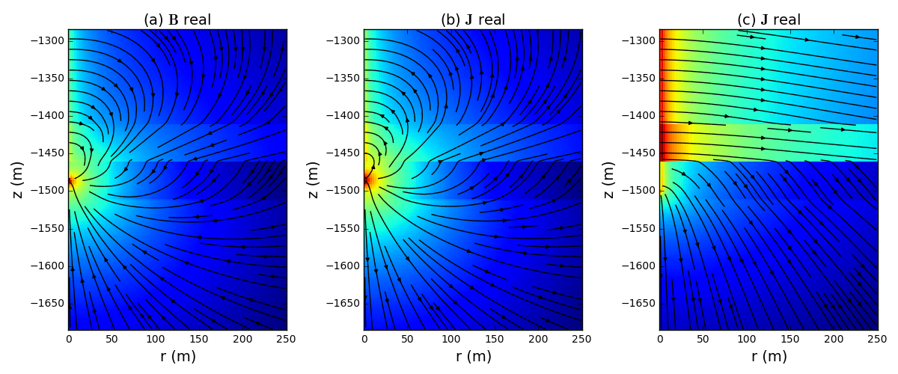
Modelling the casing: Source types
magnetic
flux density
current
density
current
density
current
density

Slide 16
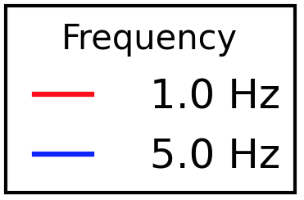
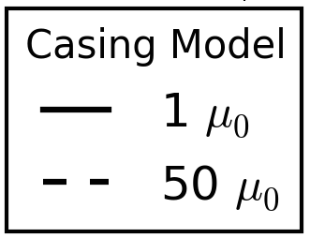
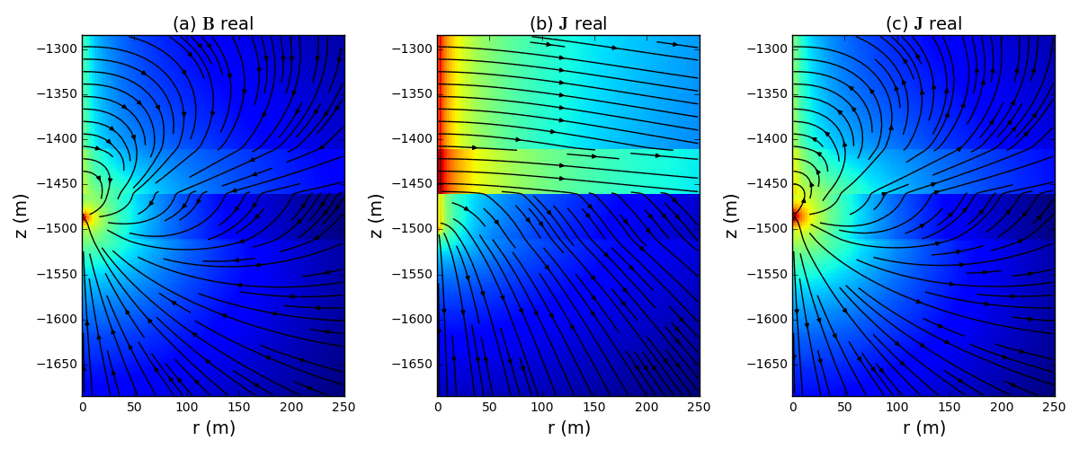
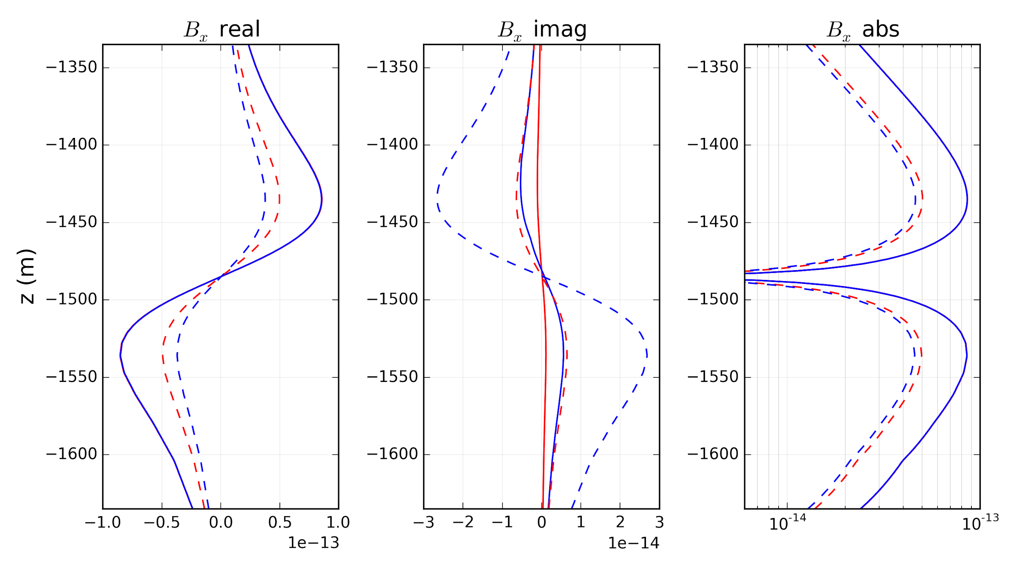
Impact of magnetic permeability:
magnetic
flux density

Slide 17
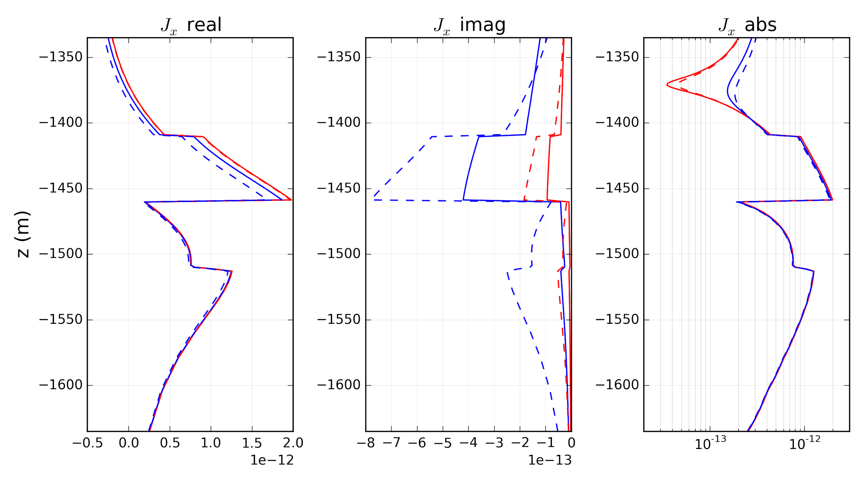
Impact of magnetic permeability:
current
density

Slide 18
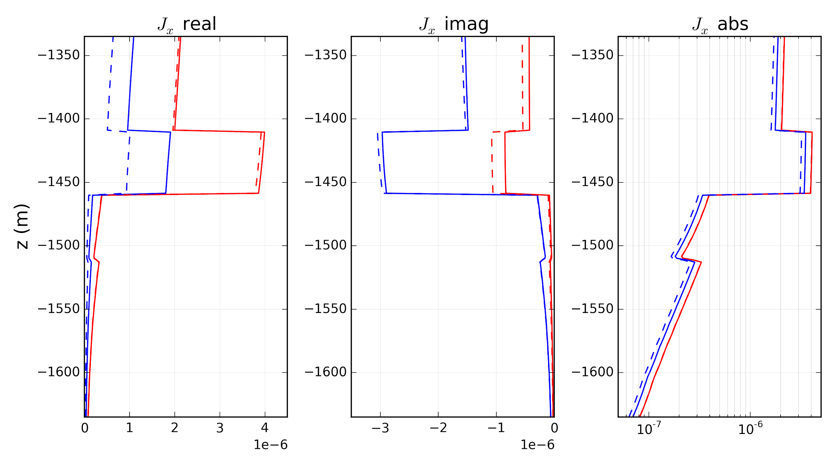
Impact of magnetic permeability:
current
density

Slide 19
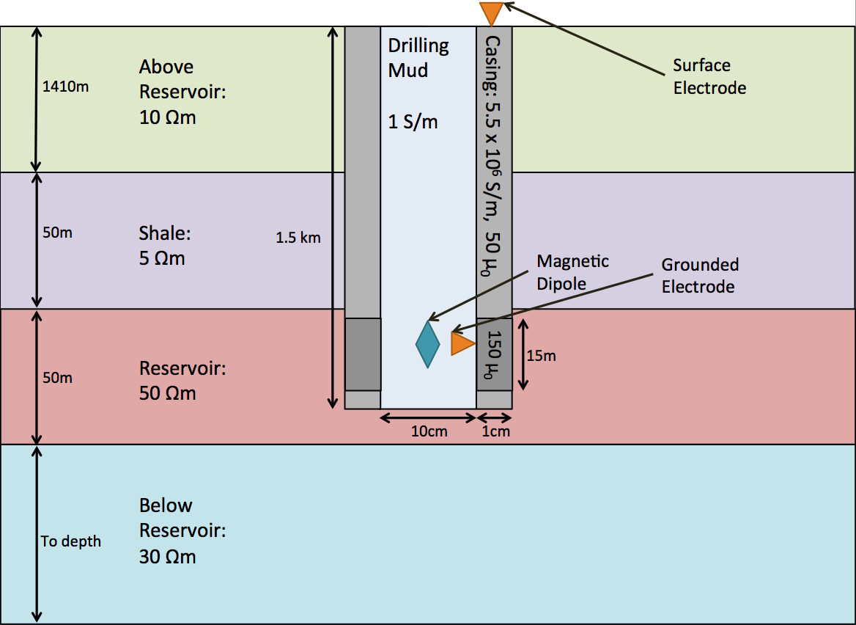
Impact of Variable Magnetic Permeability

Slide 20
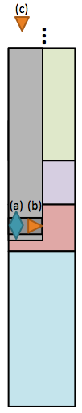
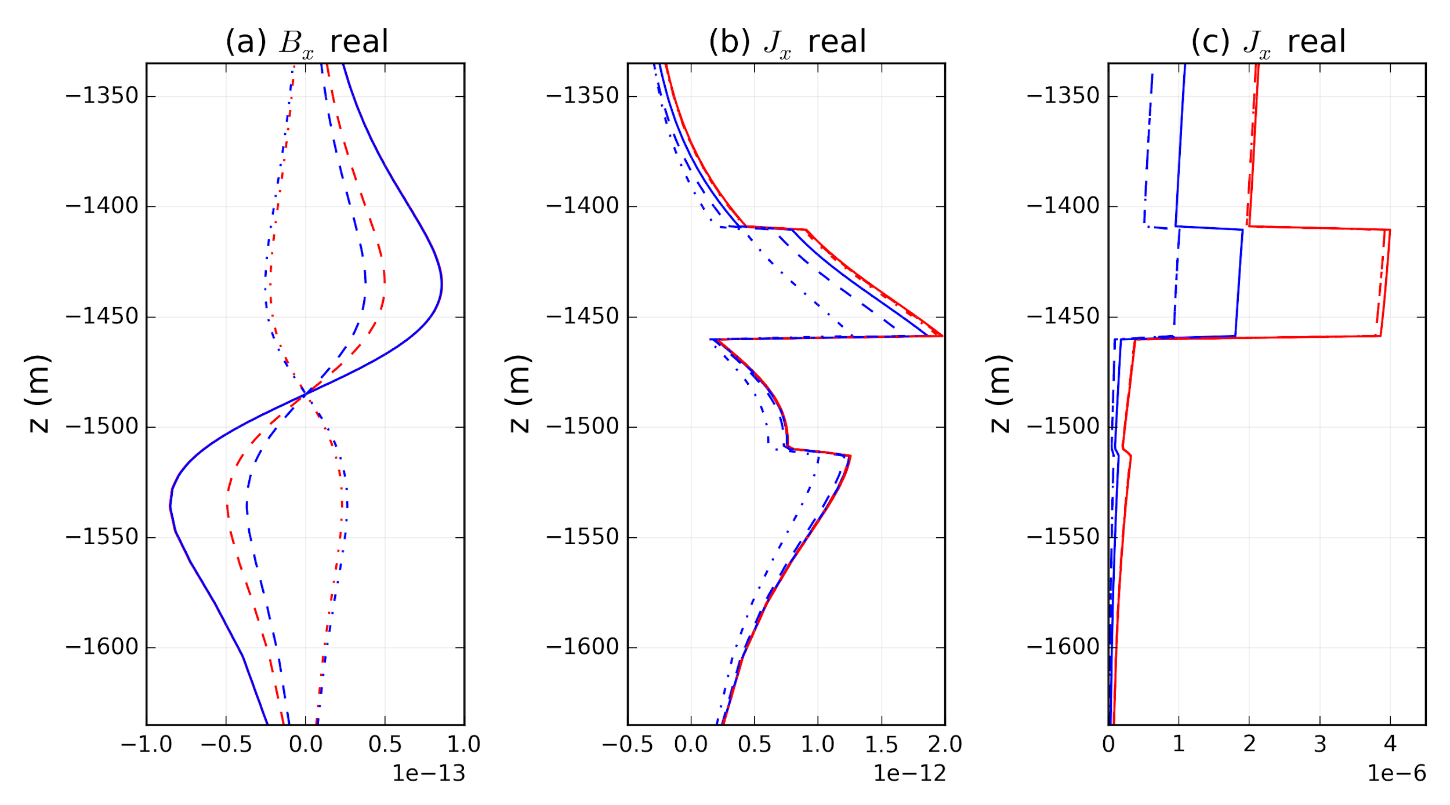
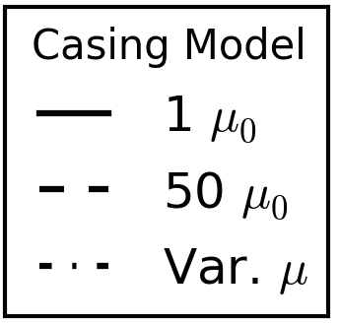
Variable Magnetic Permeability

Slide 21
Modelling with 3D geology
What we have done
cylindrically symmetric
variable
Steel casing has a significant impact on the signal
conductivity and magnetic permeability
✓
Casing & Source, Layered Earth
Notes:
Select a “result” that demonstrates the magnitude of change for 1 Hz and 5 Hz.

Slide 22
Modelling with 3D geology
What we have done
cylindrically symmetric
variable ,,
Want to model geologic structures
3 dimensional
variable
✓
?
Casing & Source, Layered Earth
Fields from casing, 3D Earth

Slide 23
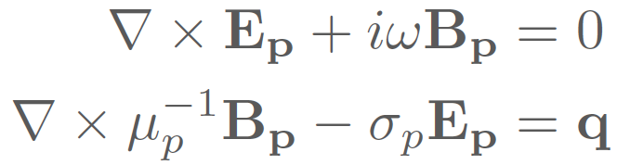
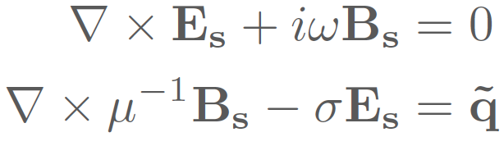
Modelling with 3D geology: Primary Secondary
Primary:
Secondary:
0
Interpolate
✓
Casing & Source, Layered Earth
Fields from casing, 3D Earth

Slide 24
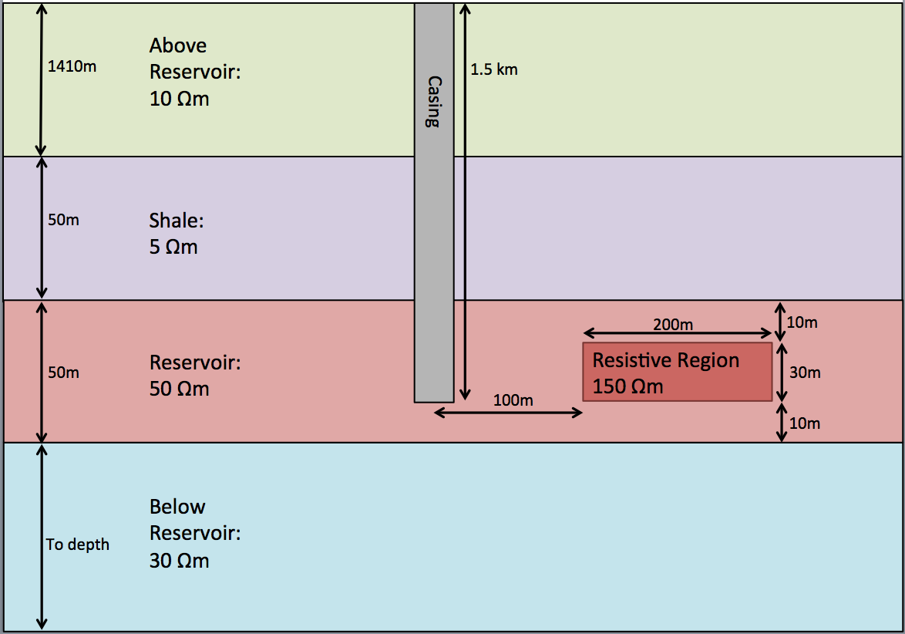
Modelling with 3D geology: Primary Secondary
Primary:
Secondary:
Interpolate
✓
Casing & Source, Layered Earth

Slide 25
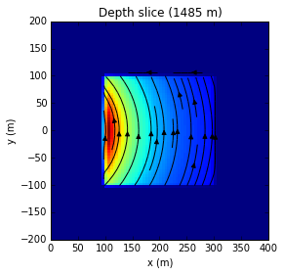
Primary-Secondary: 3D geology (magnetic dipole)
Primary:
Secondary:
Interpolate
magnetic
flux density
secondary source current density

Slide 26
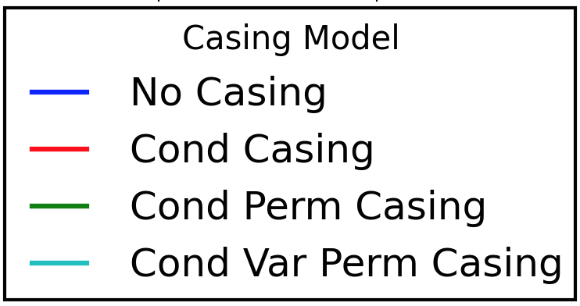
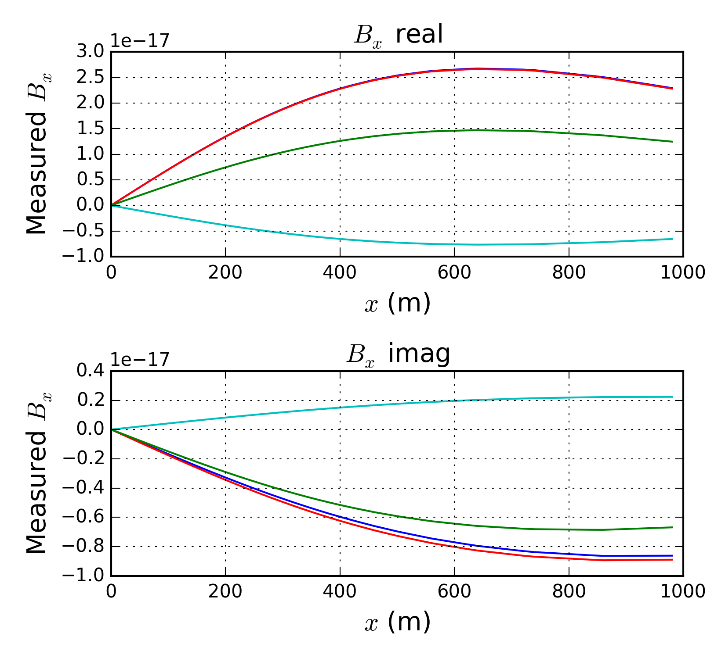
Primary-Secondary: 3D geology (magnetic dipole)
Primary:
Secondary:
Data
Source in 3D
Interpolate
Solve
magnetic
flux density
Notes:
omit the mu part in the secondary source

Slide 27

Approaching the Inverse Problem
✓
?
Notes:
can solve a single casing model or update if there is a fair amount of uncertainty in the background

Slide 28
Approaching the Inverse Problem
Estimate:
Invert for 3D conductivity :
Interpolate to compute source
Model dependence on RHS
→ need to include
in sensitivities
Solve for:
Notes:
Note: Fields from casing only need to be computed once if background conductivity estimate is good

Slide 29
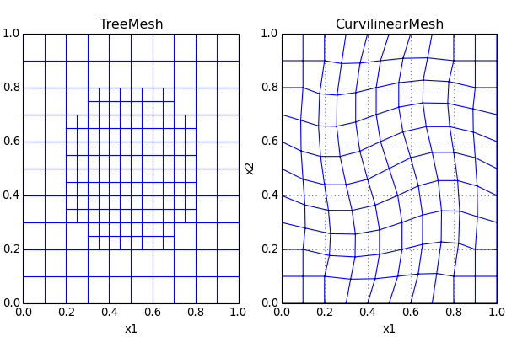
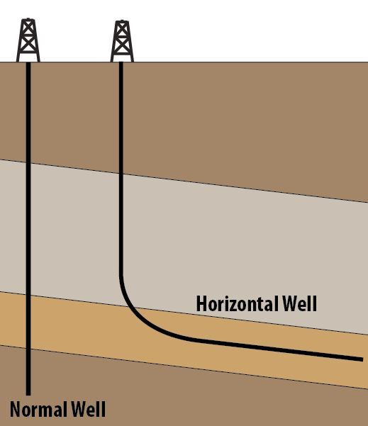
Generalizing
Time domain EM
similar approach can be applied
Non-symmetric settings:
deviated or horizontal wells
source outside of casing
Source: http://docs.simpeg.xyz/en/latest/api_Mesh.html
Source: http://www.drillingformulas.com/introduction-to-well-control-for-horizontal-wells/

Slide 30
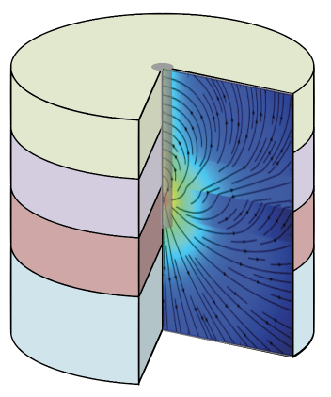
Summary
Motivation: How do we characterize 3D conductivity distributions in settings with steel cased wells?
Modelling Maxwell’s equations
Modelling the Casing
Modelling 3D geology
Approaching the inverse problem
Notes:
Modelling in FV
mu
cyl
sources
Looked at the casing
it is important!
Modelling in 3D
PS approach
Inverse formulation
complete

Slide 31


Thank you!
Thanks to:
developers of SimPEG and simpegEM
UBC GIF

Slide 32
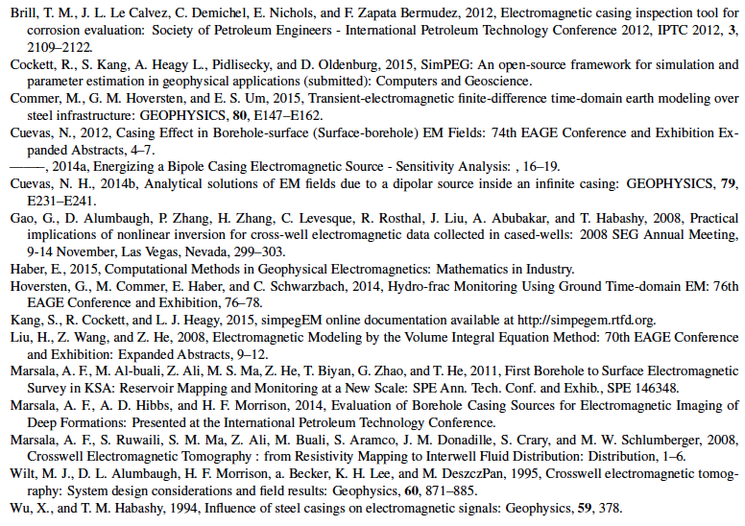
References:

Slide 33
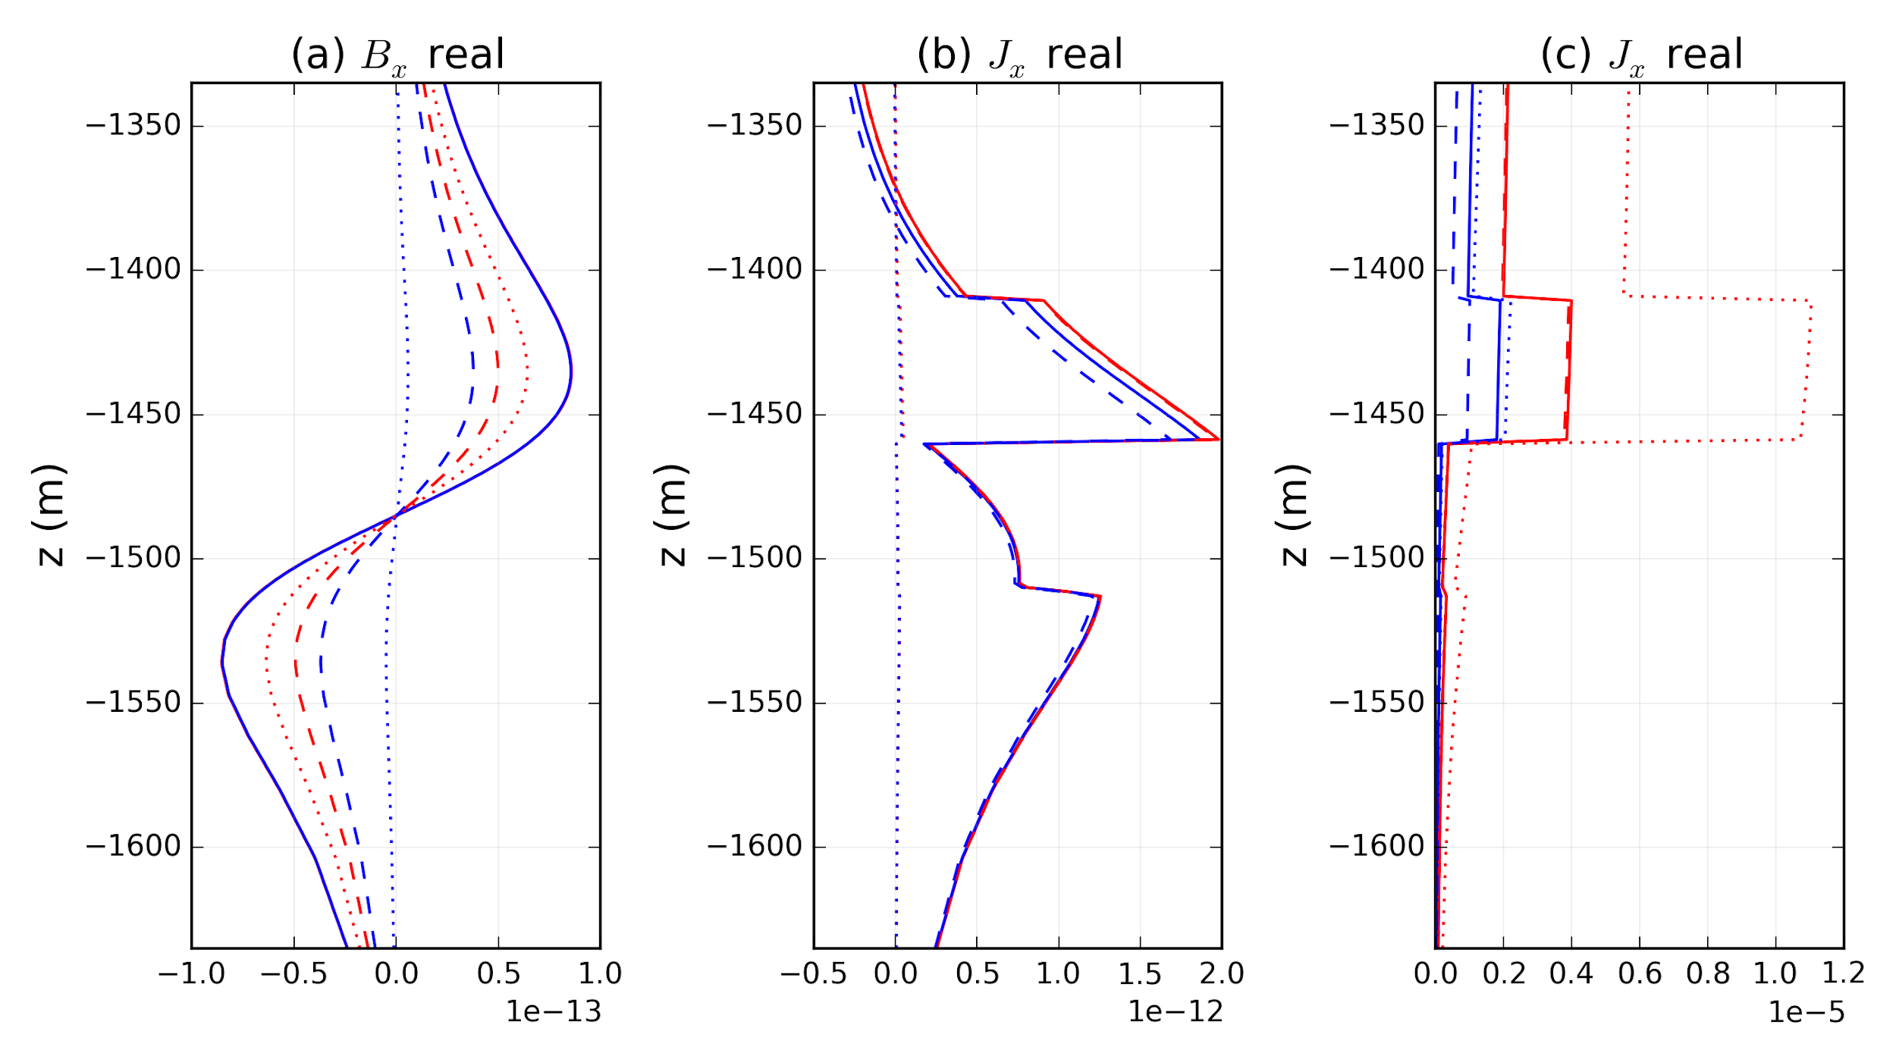
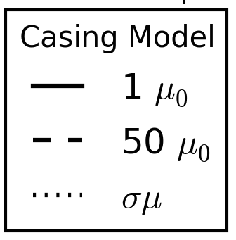
Using Conductivity Permeability product

Slide 35
SCRAPS

Slide 36
Approaching the Inverse Problem
Inversion model is conductivity
Model dependence on RHS
→ need to include
in sensitivities
Steps:
estimate background
solve for primary fields
compute source term
do inv
Notes:
can solve a single casing model or update if there is a fair amount of uncertainty in the background

Slide 37
Primary-Secondary: 3D geology (magnetic dipole)
Primary:
Secondary:
Interpolate
magnetic
flux density
Notes:
omit the mu part in the secondary source

Slide 38
Mimetic Finite Volume Forward Modelling
Physical Properties
electrical conductivity
magnetic permeability
Fluxes
current density
magnetic flux density
Fields
electric field
magnetic field

Slide 39
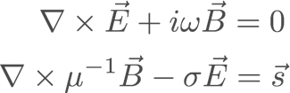
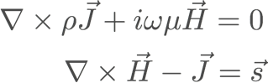
Primary: Modelling the Casing
Finite volume forward simulation
staggered grid
exploit symmetry: cylindrically symmetric
when sources on or in well
Two formulations of Maxwell:
depends on source
Cell Centers: | Physical Properties
Faces: | Fluxes
Edges: | Fields
E-B: magnetic source | H-J: electric source

Slide 40
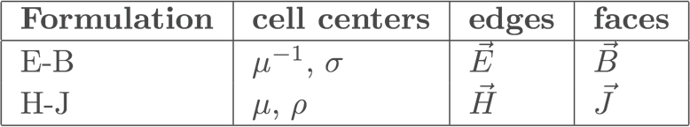
Primary: Modelling the Casing
Finite volume forward simulation
staggered grid
exploit symmetry: cylindrically symmetric
when sources on or in well
Two formulations of Maxwell:
depends on source
E-B: magnetic source | H-J: electric source

Slide 41
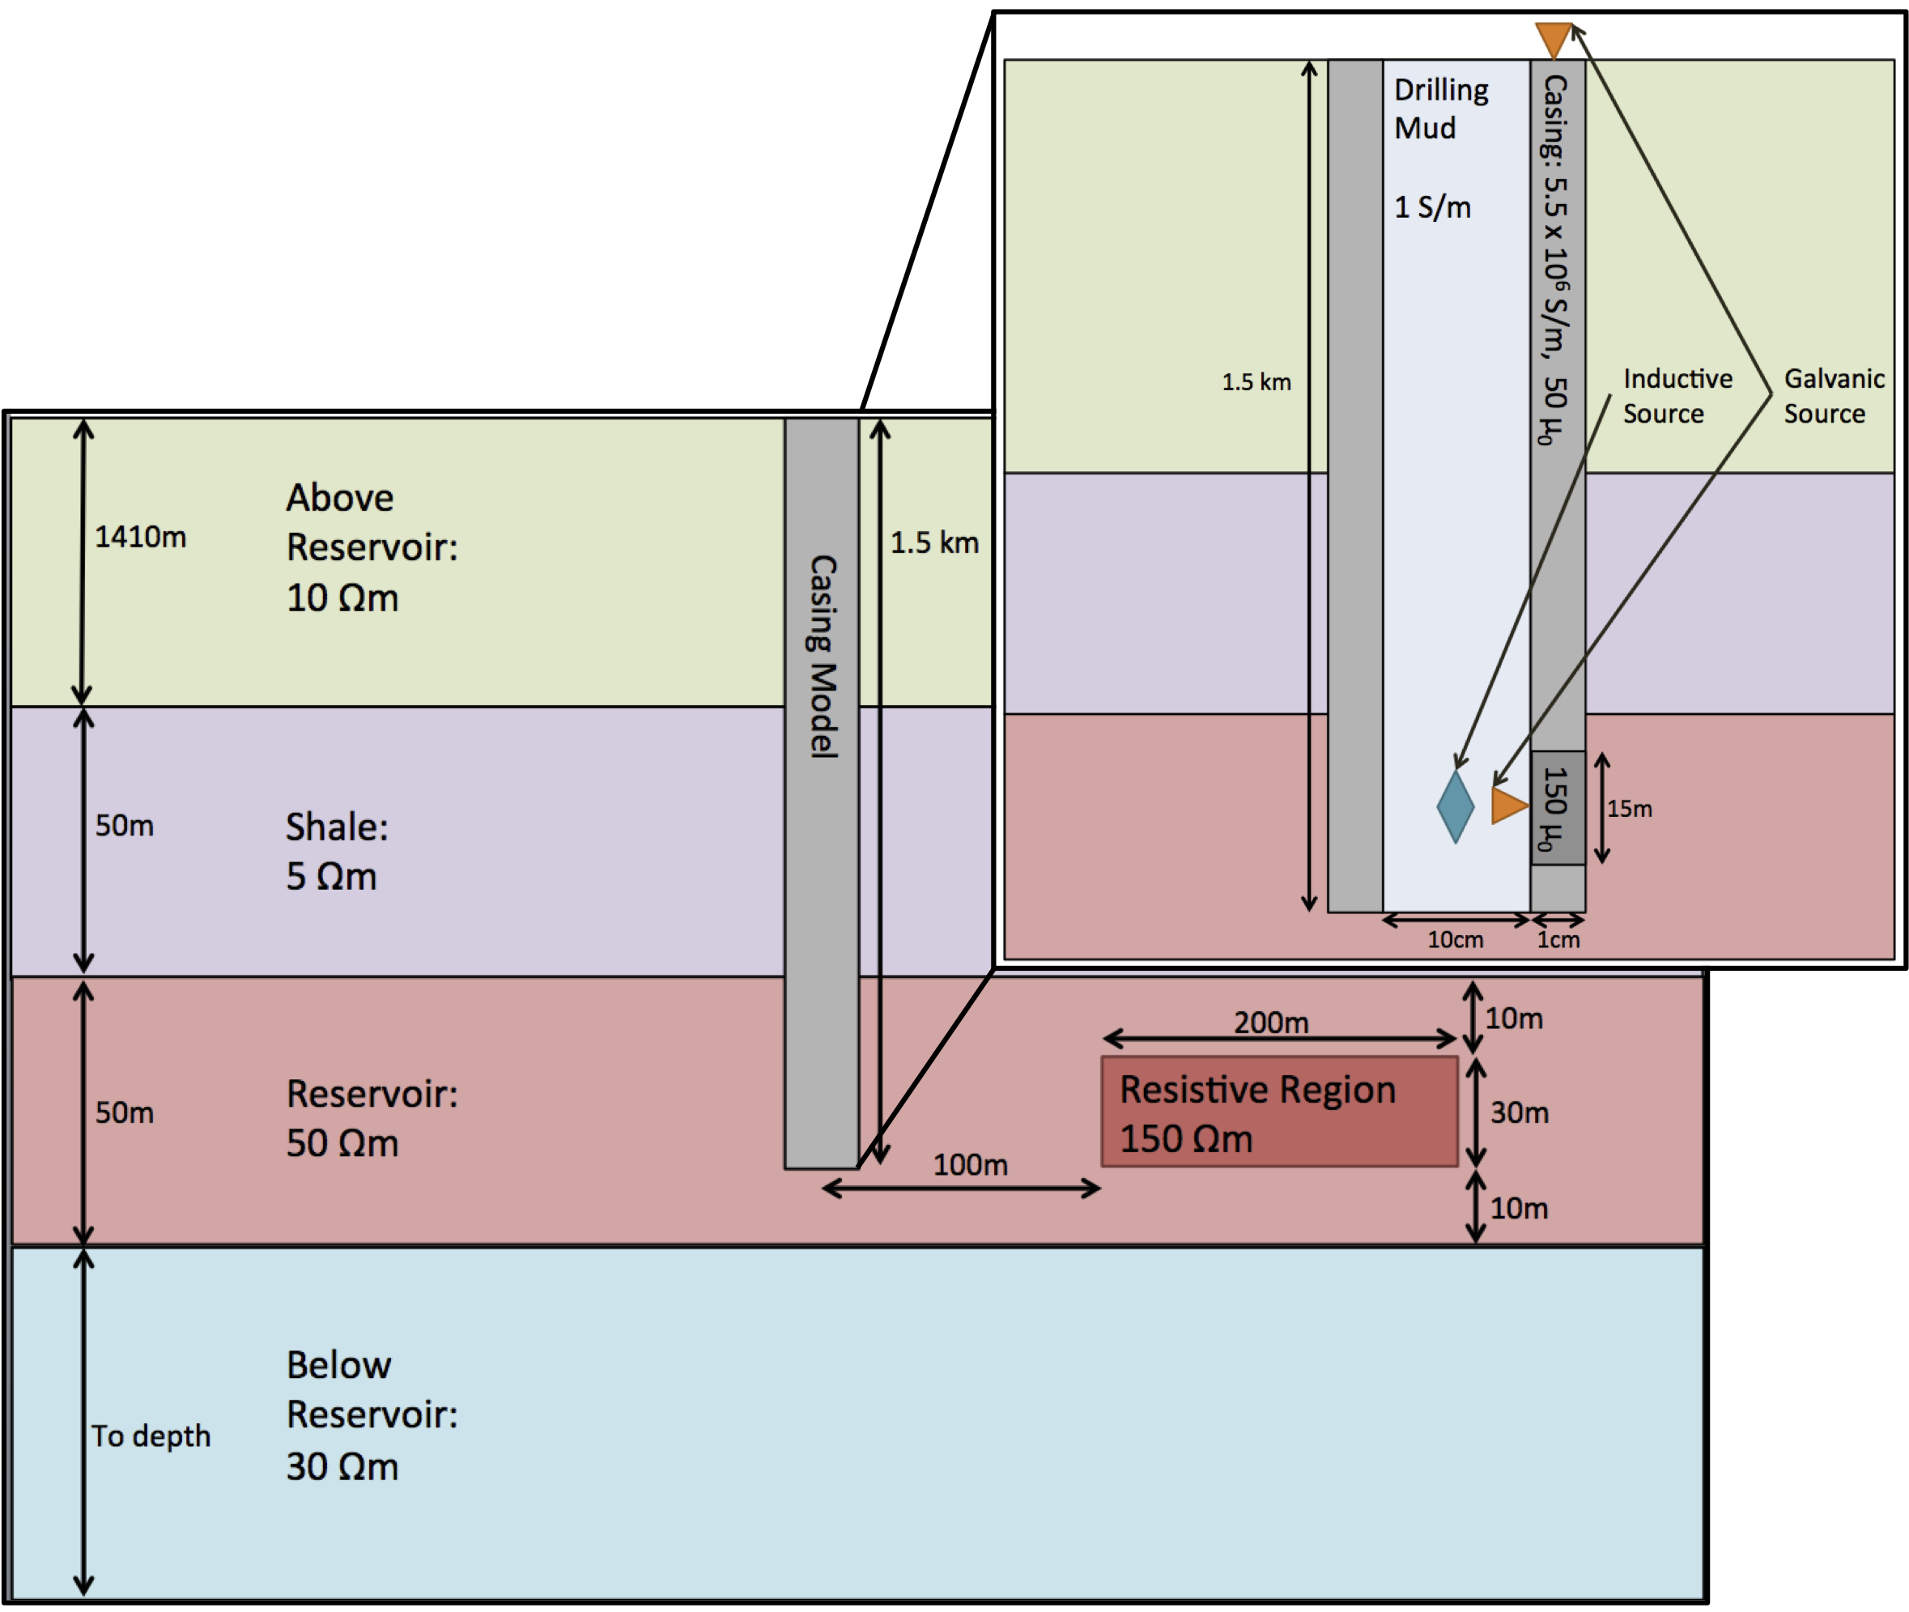
Electromagnetics in settings with cased wells
Why EM?
Electrical conductivity can be diagnostic
Cased Wells
significant contributor to signal
challenging features to model
geometry
conductivity contrast
How do we model in settings with cased wells?
Inverse Problem?
Notes:
Why EM
variations over orders of magnitude
often associated with fluids in sedimentary settings
Cased Wells:
long, thin conductive feature
conductivity contrast is orders of magnitude
more than geologic features of interest
variable conductivity, magnetic permeability, thickness

Slide 42
Primary: Cylindrical Symmetry - Summary
Two Formulations of Maxwell:
E-B: magnetic source | H-J: electric source

Slide 43
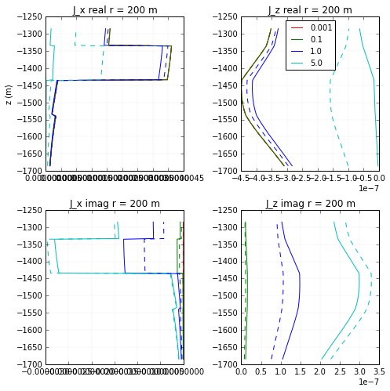
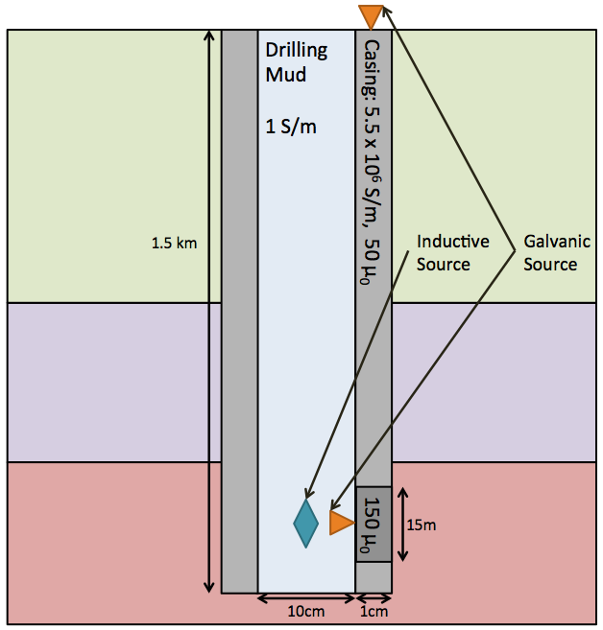
Examples: Surface Electric Src

Slide 44
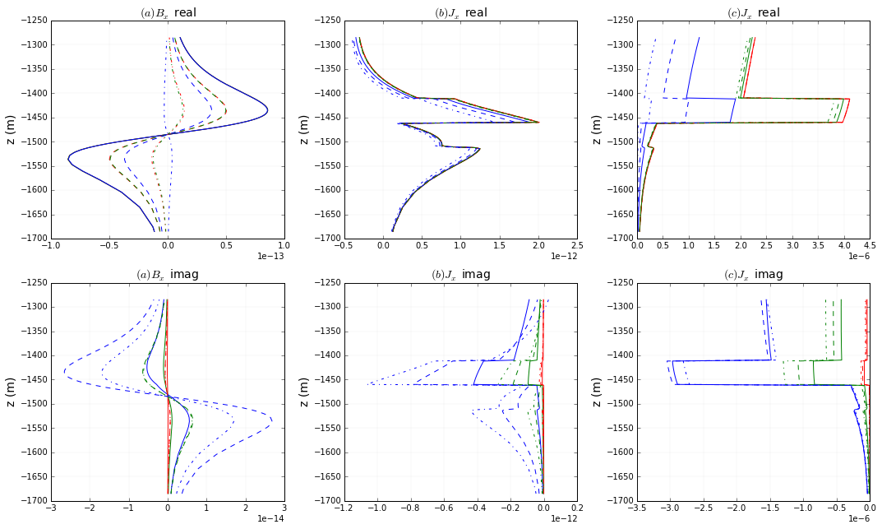

Slide 45
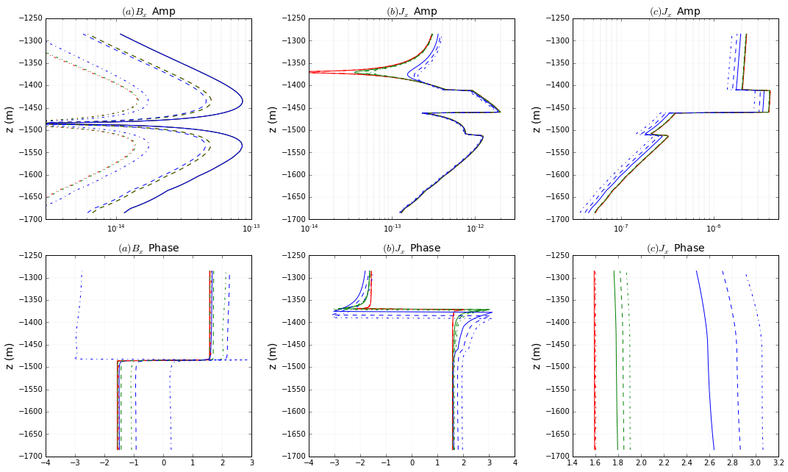

Slide 46
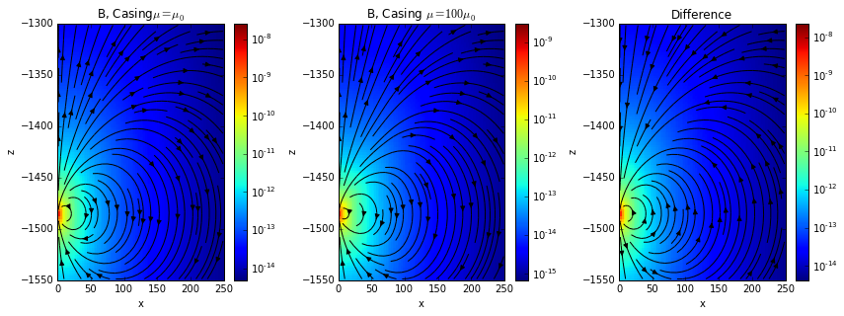
Examples: Downhole Magnetic Dipole

Slide 47
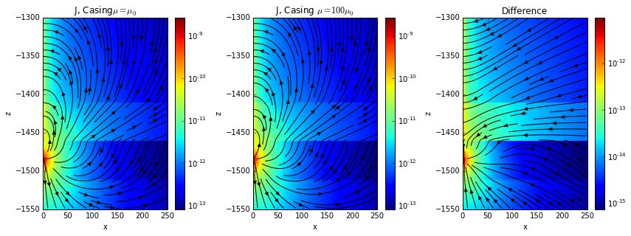
Down hole E src Couple to casing

Slide 48

Examples: Surface Electric Sc
Current!

Slide 50
magnetic
flux density

Slide 51

Variable Magnetic Permeability
Notes:
reformat for title.could omit the 0.1 Hz again.

Slide 52
Modelling the casing: Source types
magnetic
flux density
current
density
current
density
current
density

Slide 53
Approach: Break up the Problem
Example problem here
1
Primary Problem:
How do we model the casing in a simple background?
2
2. Secondary Problem:
How do model setting with 3D geologic features?

